Slide 1

Sustainable Supplier Selection Tool (PR2)
Team: OptiChainers
Sneha Bhattacharyya
Madhumanti Mallick
Saudeep Chattopadhyay
Nikita Singh
Gargi Shubham
Ishita Majumdar
Ritika Garai

Slide 2







Our Team
Sneha Bhattacharyya
Madhumanti Mallick
Saudeep Chattopadhyay
Nikita Singh
Gargi Shubham
Ishita Majumdar
Ritika Garai

Slide 3
The Procurement Predicament
Current supplier selection processes often overlook crucial sustainability metrics, leading to significant hidden risks and missed opportunities for ethical and environmental leadership.
Lack of Certification Insight
High Carbon Footprint Exposure
Reputational & Regulatory Jeopardy
Many suppliers lack essential certifications like ISO 14001, ESG ratings, or Fairtrade, making it difficult to assess their true sustainability commitment.
Without proper evaluation, procurement carries a high risk of contributing to a larger carbon footprint, impacting corporate sustainability goals.
Non-compliance with sustainability targets exposes organizations to severe reputational damage and increasing regulatory penalties.

Slide 4








Introducing PR2: Our Sustainable Solution
Our innovative tool evaluates and ranks suppliers based on comprehensive sustainability criteria, empowering procurement teams to make informed, responsible choices.
ESG Ratings
Emissions Intensity
Comprehensive environmental, social, and governance scores.
Analysis of Scope 1, 2, and 3 carbon emissions (tCO₂e).
Decarbonization Policies
Key Certifications
Assessment of supplier commitments to carbon reduction targets.
Verification of ISO 14001, B-Corp, and Fairtrade statuses.
Outputs include: detailed supplier scorecards, dynamic ranking for procurement, and an intelligent comparison engine for optimal recommendations.

Slide 5
Unleashing Unique Value
PR2 isn't just another tool; it's a strategic advantage for building a resilient and responsible supply chain.
1
2
Transparent Ranking
Configurable Weights
Clear, auditable scoring breakdown across multiple sustainability dimensions provides unparalleled clarity.
Tailor evaluation criteria to align precisely with your company's unique sustainability priorities.
3
4
Sustainability-First Mandate
Seamless Integration
Ensures every procurement decision actively contributes to achieving ESG targets and commitments.
Designed for effortless adoption alongside existing procurement workflows and systems.

Slide 6
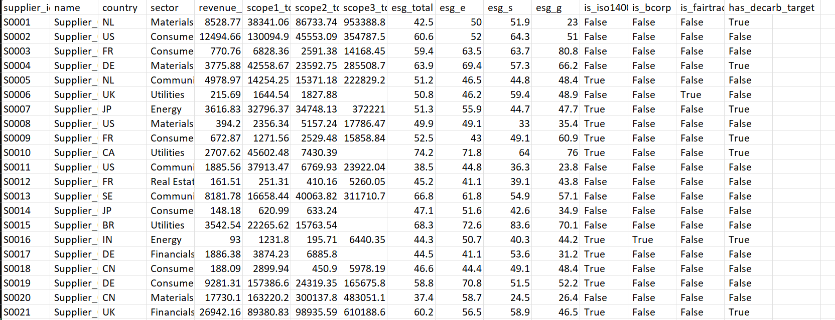
Robust Data Foundation
For this demonstration, we've meticulously curated a fabricated dataset that mirrors real-world supplier profiles, ensuring our tool's relevance and accuracy.
Revenue (USD millions): Reflects typical business scale.
Scope 1, 2, 3 Emissions (tCO₂e): Realistic ranges for direct, indirect, and value chain emissions.
ESG Scores: Diverse scores representing varying levels of sustainability performance.
Certifications & Policies: Binary indicators for key environmental and ethical standards.
This dataset spans suppliers with widely varied carbon footprints and certification statuses, providing a competitive testing ground.

Slide 7
Dataset Structure at a Glance
Here's a snippet of the key attributes in our demo dataset, showcasing the depth of information used for supplier evaluation.
supplier_name
Unique identifier for each supplier.
revenue_usd_m
Annual revenue in millions of USD.
scope1_tco2e
Direct emissions (tonnes CO₂ equivalent).
scope2_tco2e
Indirect emissions from purchased energy.
scope3_tco2e
Other indirect value chain emissions.
esg_total
Overall ESG performance score (0-100).
is_iso14001
Boolean: ISO 14001 certified (environmental mgmt).
is_bcorp
Boolean: B-Corp certified (social/environmental perf).
is_fairtrade
Boolean: Fairtrade certified (ethical sourcing).
has_decarb_target
Boolean: Has a public decarbonization target.

Slide 8
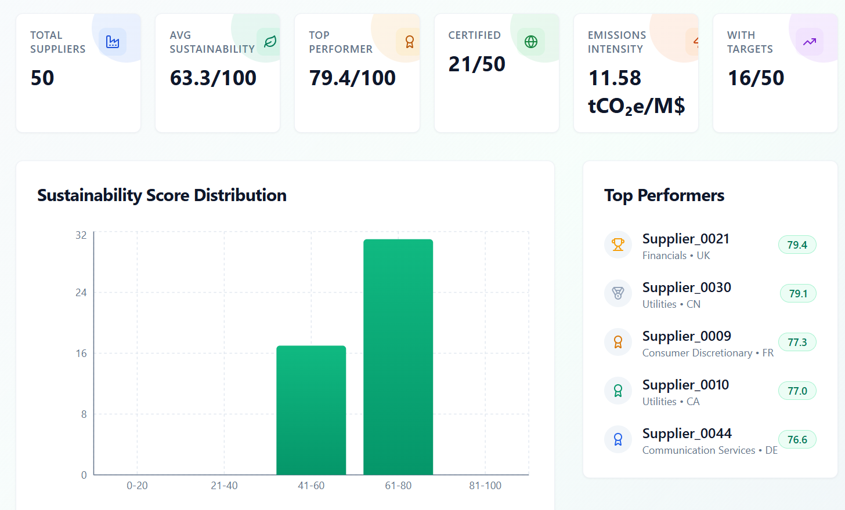
Intuitive Web Interface
Our user-friendly interface allows for quick data processing and customized evaluation to fit your specific procurement needs.
1
2
Upload Supplier Data
Configure Custom Weights
Effortlessly import your supplier information via CSV or direct DB connection.
Adjust the importance of ESG, Carbon, and Certifications to match your company's priorities.
3
Generate Rankings & Visuals
Instantly receive a ranked supplier table and insightful data visualizations.
Live Interface Link: https://procurement-app-red.vercel.app/

Slide 9



Algorithmic Precision
Our ranking algorithm meticulously normalizes diverse data points and applies configurable weights to provide an accurate, actionable supplier score.
Diverse Inputs
Smart Normalization
Customizable Weights
ESG ratings, emissions intensities, certifications, and policies.
Factors converted to a uniform scale (0-1), accounting for "benefit" (higher is better) vs. "cost" (lower is better).
Procurement teams set weights based on their company's strategic ESG priorities.
Final Outputs: A precise supplier score (0-1), a clear ranking from best to worst, and a tie-breaking mechanism (first by ESG, then by emissions) for ultimate clarity.

Slide 10
Under the Hood: Ranking Logic
Our core algorithm combines weighted sustainability factors to generate a comprehensive score for each supplier.
df["score"] = ( w_esg * df["esg_total_norm"] + w_s1 * df["s1_norm_cost"] + w_s2 * df["s2_norm_cost"] + w_s3 * df["s3_norm_cost"] + w_certs * df["certs_norm"] + w_policy * df["policy_norm"])
This simplified Python snippet illustrates how individual normalized factors—ESG score, Scope 1, 2, and 3 emissions, certifications, and decarbonization policies—are multiplied by their respective weights (w_esg, w_s1, etc.) and summed to derive a final composite score.
Here eg, from Data-set Supplier_0038 who Ranked 10.
GitHub Repository: https://github.com/Sneha-Bhattacharyya/Procurement_App

Slide 11
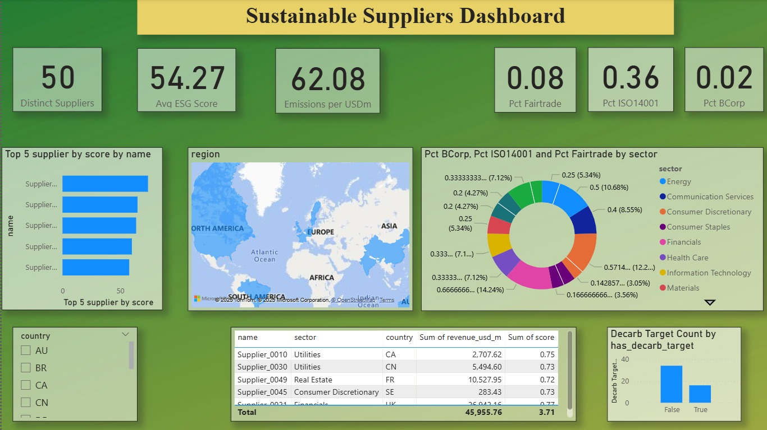
Visualizing Impact with Power BI
Our Power BI dashboard transforms raw data into compelling visuals, offering actionable insights into your supply chain's sustainability performance.
PowerBI Dashboard File: https://github.com/Sneha-Bhattacharyya/Procurement_App/blob/main/sustainable%20supplier%20dashboard.pbix
The dashboard includes dynamic bar/pie charts for supplier score distribution, interactive ranking tables with filtering capabilities, a detailed breakdown of supplier certifications, and comparative views of Scope 1/2/3 emission intensities.

Slide 12




Power BI Development Steps
Data Ingestion
Data Transformation
Seamlessly import our curated, fabricated dataset into Power BI for analysis.
Apply algorithmic normalization and user-defined weights to compute accurate supplier scores.
Dynamic Visuals
Enhanced Interactivity
Create interactive tables for rankings, pie charts for certifications, and bar charts for emissions.
Implement slicers for refined data exploration by supplier size, industry sector, and geographical region.

Slide 13



Conclusion: Delivering a Sustainable Future
PR2 is more than a tool; it's your strategic partner in building a resilient, responsible, and compliant supply chain.
Empowering Evaluation
Minimising Carbon Risk
Ensuring ESG Compliance
Provides transparent, configurable, and sustainability-driven supplier evaluation for informed decision-making.
Actively reduces carbon and environmental risks inherent in your procurement processes.
Guarantees adherence to evolving ESG mandates, strengthening responsible sourcing commitments.

Slide 14





Alternative Suggestions
While PR2 already provides robust sustainable supplier selection, here are some key areas for future expansion and enhancement to unlock even greater value:
Integrate Real-Time Databases
Automate with ESG APIs
Directly connect with leading supplier sustainability platforms like CDP, EcoVadis, and Sedex for real-time data ingestion and verification.
Leverage APIs from prominent ESG data providers to automate data collection, ensuring up-to-date and comprehensive supplier profiles.
Predictive Risk Scoring
Expand Social & Governance Metrics
Implement machine learning models to develop predictive risk scores, identifying potential future sustainability issues before they arise.
Broaden the scope to include a wider array of social factors (e.g., labour practices, human rights) and governance indicators (e.g., board diversity, anti-corruption policies).

Slide 15
Thank You

